Slide 1

Cochise Linux User Group

Slide 2

Ubuntu 24.04 Noble Nombat

Slide 3
What’s New
First of all there is a new and “improved” installer.
It is built in Flutter and underpinned by Subiquity and Curtin.

Slide 4
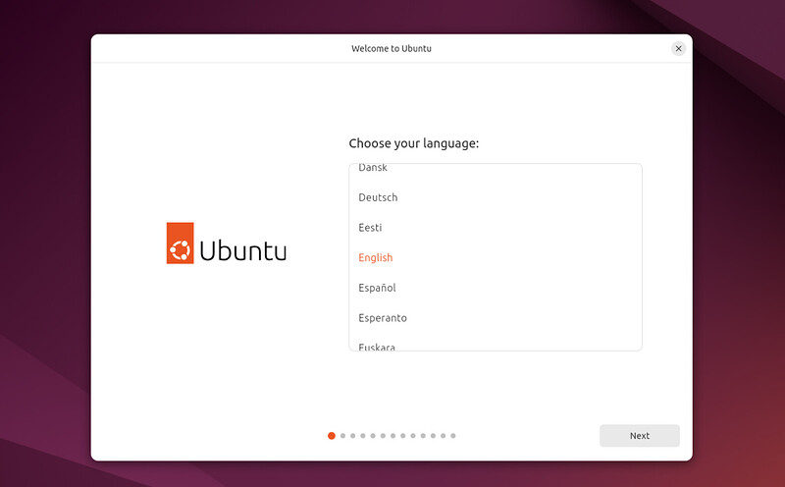
Installing-1

Slide 5
Accessability
You now have the ability to use “provisioning” (though a .yaml file) to automate installation and configure accessibility options prior to install (such as seeing, hearing, pointing & clicking and zoom).

Slide 6
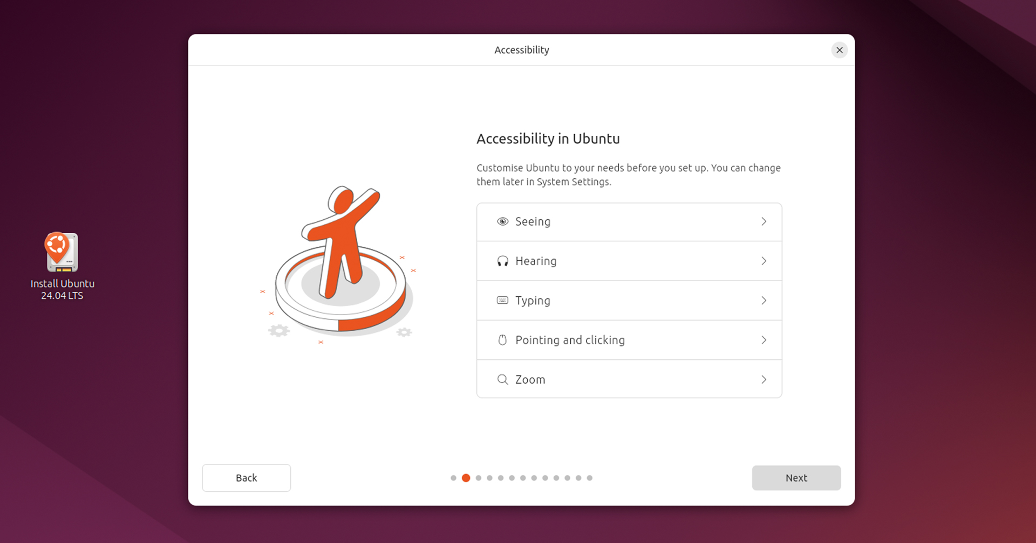
Installing-2

Slide 7
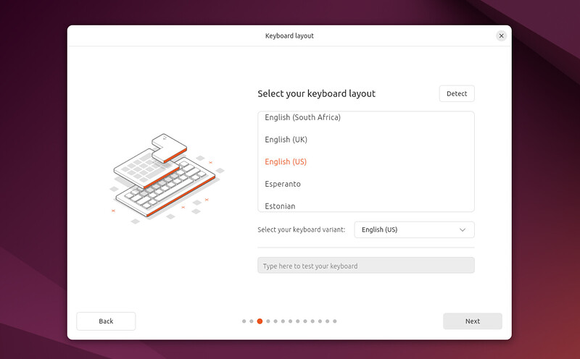
Installing-3

Slide 8
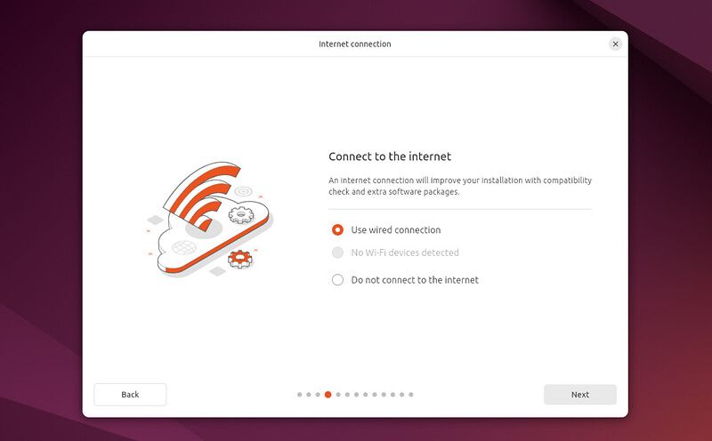
Installing-4

Slide 9
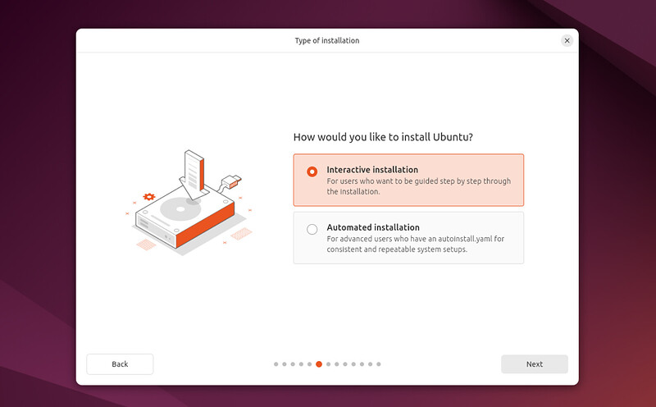
Installing-6

Slide 10
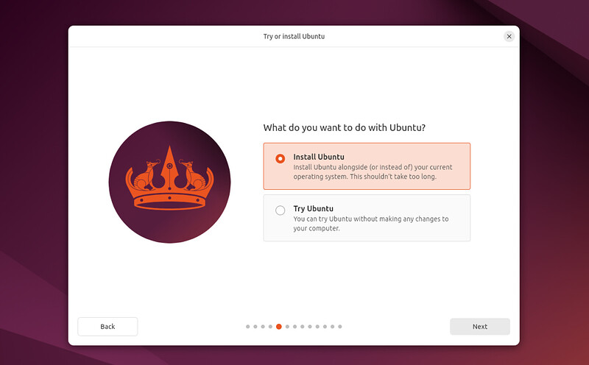
Installing-5

Slide 11
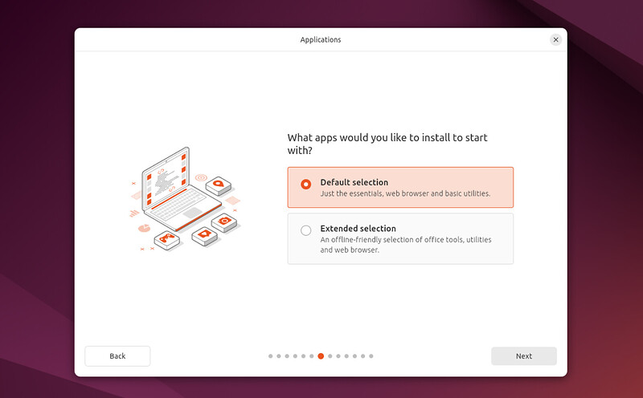
Installing-7

Slide 12
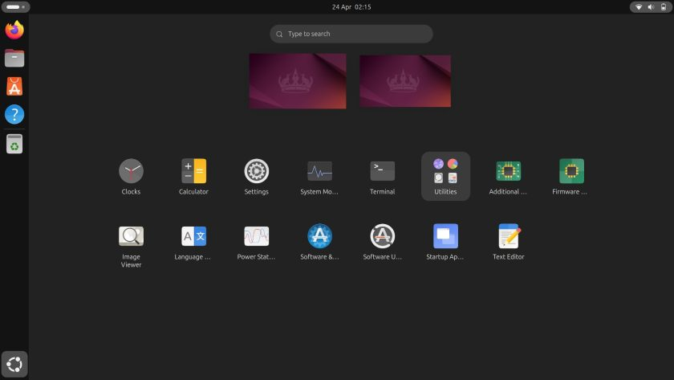
Minimal Install

Slide 13
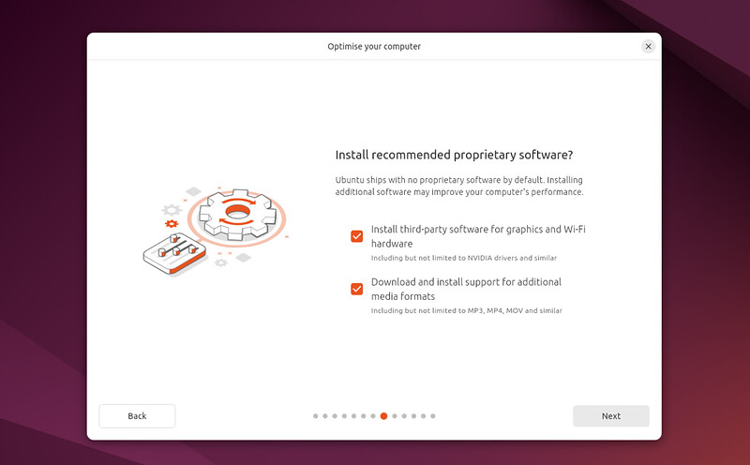
Installing-8

Slide 14
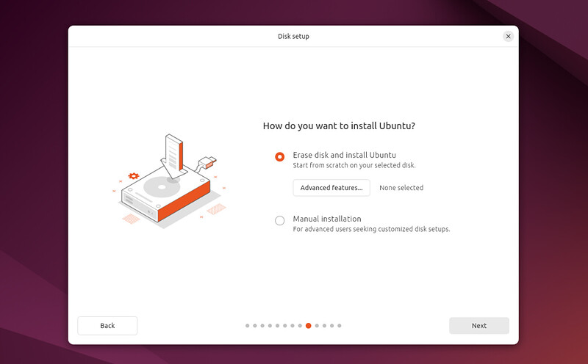
Installing-9

Slide 15
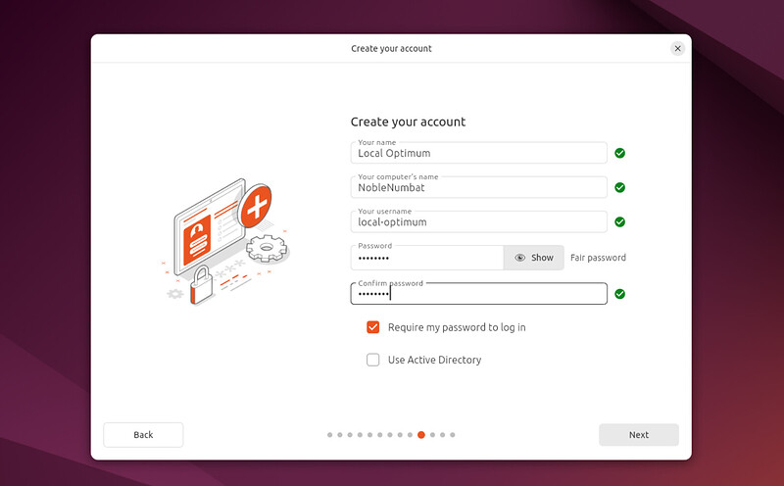
Installing-10

Slide 16
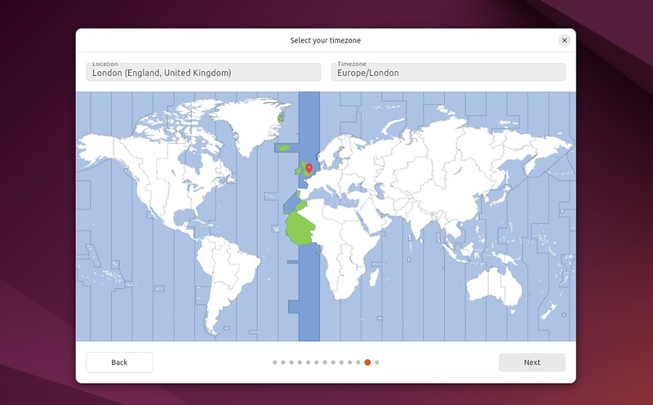
Installing-11

Slide 17
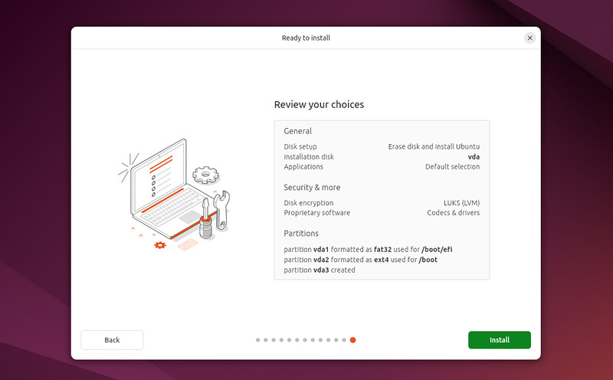
Installing-12

Slide 18
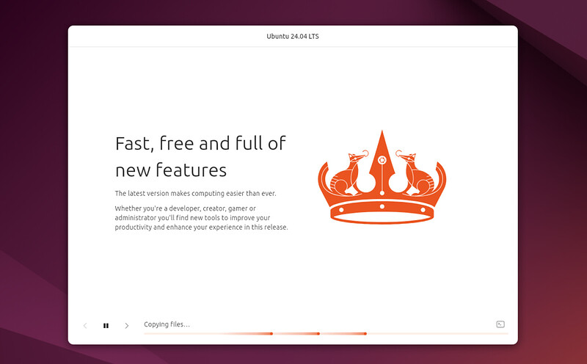
Installing-13

Slide 19
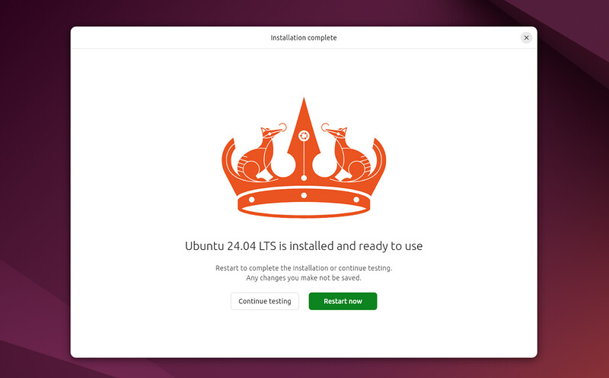
Installing-14

Slide 20
Other Major Changes-1
Ships with Gnome 46
Ships with Linux kernel 6.8

Slide 21
Other Major Changes-2
New Systems Menu option which contains:
  Region & Language
  Date/Time
  Users
  Remote Desktop
  Secure Shell
  About

Slide 22
Other Major Changes-3
No games are installed by default
New Clock App

Slide 23
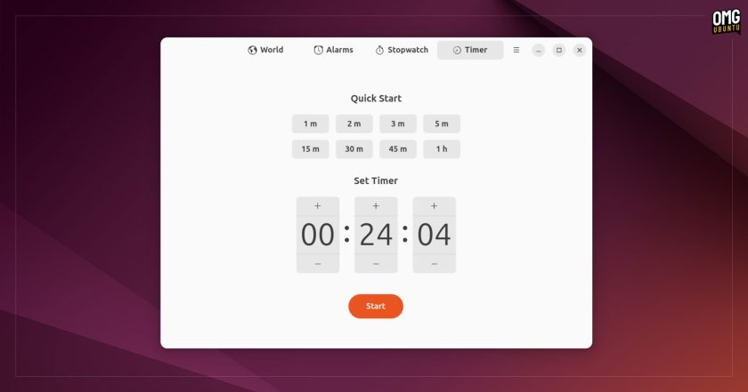
Clock App

Slide 24
Other Major Changes-4
Privacy has been renamed Privacy & Security

Slide 25
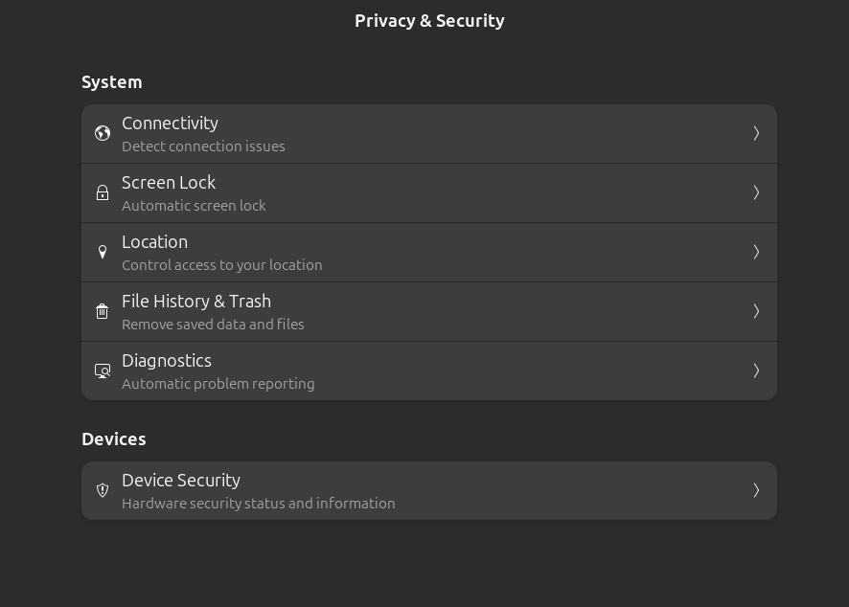

Slide 26
Other Major Changes-5
The App Center replaces the Snap Store and is snap oriented. For instance Thunderbird is now installed as a snap.
If you want deb files, you can use the search function, select “See all results for XXX” or use the command line.

Slide 27
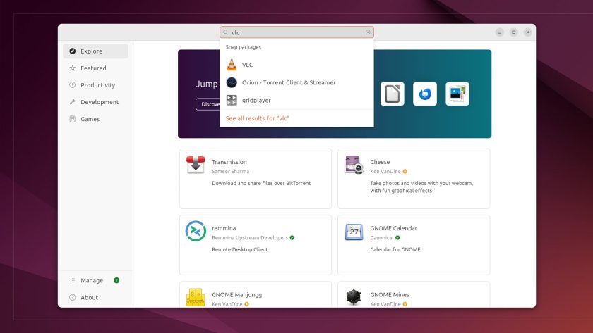
App Center

Slide 28
Other Major Changes-6
Files App has been revamped
  A massive improvement to the file search functionality within the Files application, introducing a new global search.
  The tracking of any file operations has now been relocated to the bottom left corner of the Files interface.
  Users can now select their preferred format for displaying the date and time on files in either List or Grid view, with “Simple” or “Detailed” available.
  Lightning-fast switch between “List” and “Thumbnail” views.

Slide 29
Other Major Changes-7
Improved Mouse & Touchpad Settings

Slide 30
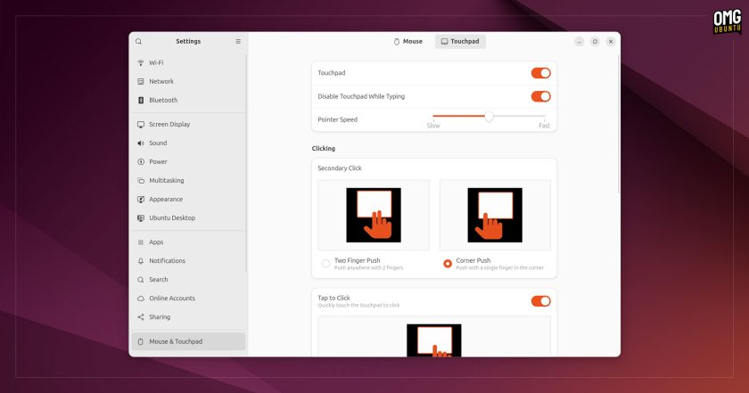
Mouse & Touchpad Settings

Slide 31
Other Major Changes-8
Users will quickly see a new scrollable dynamic workspace indicator in the top left corner, which has replaced the old “Activities” three-dot button. The Ubuntu logo icon at the bottom of the left panel provides easy access to the GNOME’s overview screen.

Slide 32
Other Major Changes-9
The revamped Quick Settings offers easy access to various features, such as Wi-Fi and Bluetooth, switching themes from light to dark, adjusting power modes, and more.

Slide 33
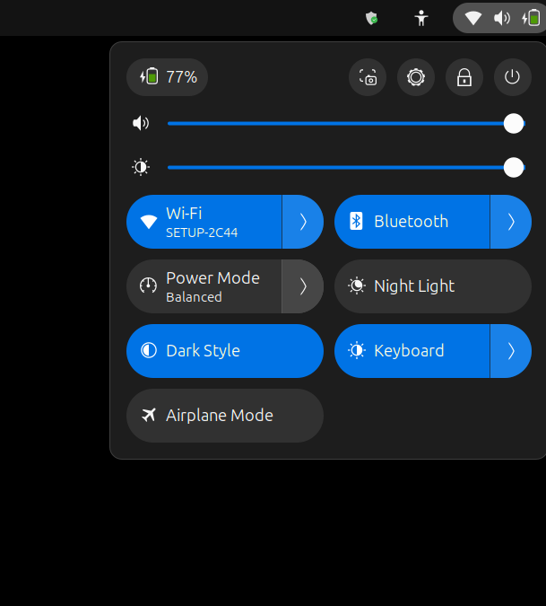
Quick Settings

Slide 34
Other Major Changes-10
Unlike the earlier 22.04 LTS version, the new Noble Numbat release brings major improvements to desktop window tiling—the feature that allows you to snap windows to the edges or corners of your screen.
Previously, you could only snap windows to the screen’s left, right, top, or bottom. Now, with Ubuntu 24.04 and the introduction of the brand-new “Ubuntu Tiling Assistant,” you can snap windows into any quarter of the screen.

Slide 35
Other Major Changes-11
In the media field, PipeWire (v1.0.4) has become the default sound server in the Noble Numbat release. While it was included in the earlier 22.04 Jammy Jellyfish version, it only managed video streams then. Now, in 24.04, it has been promoted to handle all audio and video tasks, ensuring a seamless multimedia user experience.

Slide 36
Other Major Changes-12
Noble Numbat has introduced a new Firmware Updater application that works on both AMD64 and Arm64 systems. It features a user-friendly graphical interface, making it easy to update your device’s firmware directly without keeping a full app store open in the background.

Slide 37
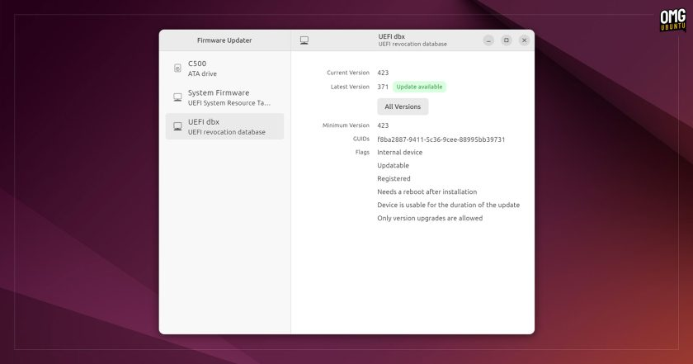
Firmware Updater

Slide 38
Other Major Changes-13
Ubuntu 24.04 is set to be the first LTS release to support the Raspberry Pi 5. It will provide comprehensive support with both arm64 server and desktop images specifically designed for the latest Raspberry Pi model.

Slide 39
Other Major Chages-14
As is the case with all previous LTS (Long Term Support) releases, Ubuntu 24.04 comes with a five-year support period. In other words, Noble Numbat will receive updates and security patches until April 2029.

Slide 40
Other Major Changes-15
Canonical offers Ubuntu Pro, a subscription service for users and organizations needing more extensive support. It extends the support period and enhances the OS’s coverage to an impressive 12-year period.
Ubuntu Pro offers additional security features, such as live kernel patching. This allows users to apply critical kernel patches without rebooting their systems, ensuring the overall security posture without disrupting operations.

Slide 41
Cochise Linux User Group

